Slide 1
Predicting Wildfire- An Analytical Approach
Submitted By:
Mohit Asija 0734856
Gurmanjit Singh Sahni 0734775
Pratik Prashant Teredesai 0734870
Guided by: Prof. Muhammad Shahid

Slide 2
Why we choose this?
90% of all wildfires are started by humans.
An average of 1.2 million acres of US woodland burn every year.
It takes an average of 2-4 years after a wildfire before reforestation efforts can begin.
Climate change, as predicted, is fueling longer, stronger, and quicker-to-start wildfires.

Slide 3
Flow of Project
Problem Statement
Analytical Problem
Data Collection
Data Cleaning
Exploratory Data Analysis
Model Building
Visualization

Slide 4
Problem statement
Wildfires have become a major concern in the recent past which had a huge impact on both the environment and the living beings as well.
There have been numerous wildfires that go un-noticed only the major ones get the media coverage.
It would be a major to predict the same with frequency or consistency.
The predictions is the most important step in the Project.

Slide 5
Analytical Problem
Our motive through this project is to overcome, predict and map the countries which are prone to wildfires.
Also the reasons why wildfires are happening in that particular area and how they can be controlled.

Slide 6
About the dataset:
Its an open database available by U.S. Govt.
The Dataset Consists of 31 Attributes
1.88m Rows
Geo-Spatial Data
Timestamps
Various fire codes
Reasons of wildfire
Data is in sqlite format which has many tables but we will be working with few of them only because many tables are virtual which is not important for our data.

Slide 7
5 C’s framework of ethics
Consent: The data is available on Kaggle and has been uploaded by US Govt and anybody can use it for analysis purpose.
Clarity: We are clear intention that we will be using this data for our project.
Consequences: As this is not a sensitive data and it is open to everybody so it does not have any consequences. The data will not harm anybody.
Control: The data is controlled and updated my US Govt.
Consistency: Yes our dataset is consistent but it is not dynamic so there should not be any problem with consistency.

Slide 8
Data Dictionary
SOURCESYSTEMTYPE
SOURCESYSTEM = Name of Source
NWCGREPORTINGAGENCY
NWCGREPORTINGUNIT_ID
NWCGREPORTINGUNIT_NAME
SOURCEREPORTINGUNIT
FIRE_CODE
FIRE_YEAR
DISCOVERY_DATE
DISCOVERY_TIME
FIRE_SIZE

Slide 9
Data Dictionary
FIRESIZECLASS
LATITUDE
LONGITUDE
STATE
COUNTY
Geographic Area
Unit Type
Department
Agency
Country
State

Slide 10
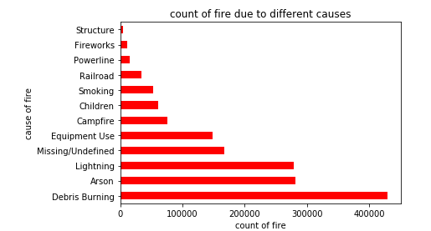
Exploratory Data Analysis: Cause of Wild Fires

Slide 11
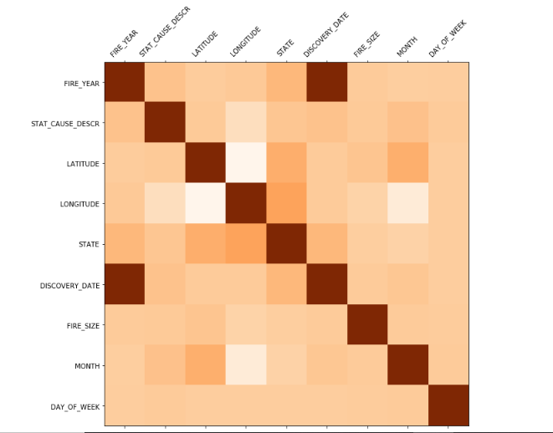
Correlation

Slide 12
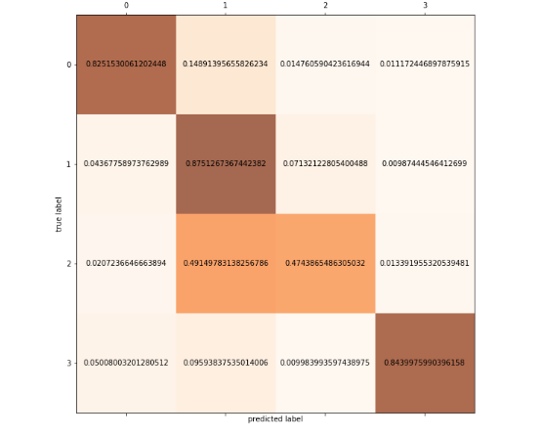

Confusion Matrix

Slide 13
Models Trained
Linear Regression
Random Forest
Decision Tree
SVM
Gradient Boosting
XG Boost
MLP( Multiple Layer Perceptron)

Slide 14
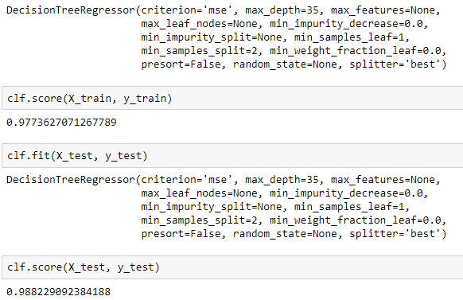
Decision Tree Classifier

Slide 15
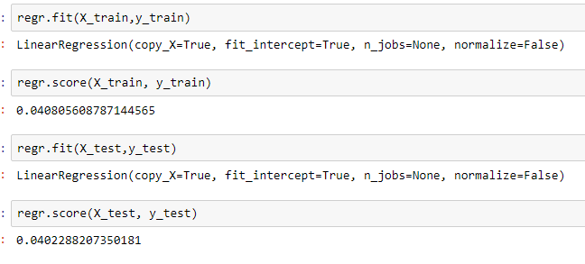
Linear Regression

Slide 16
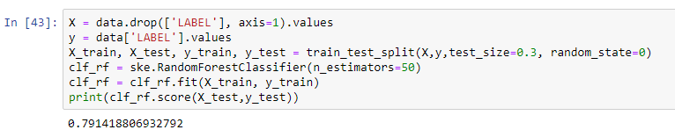
Random Forest

Slide 17
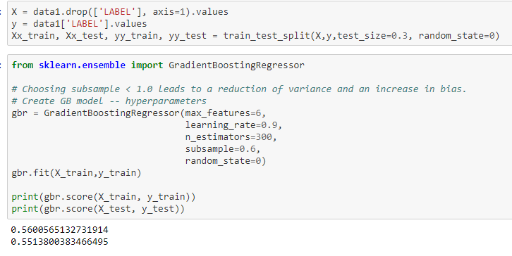
Gradient Boosting

Slide 18
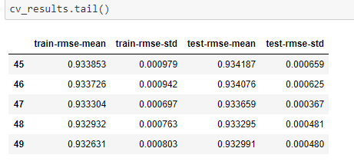
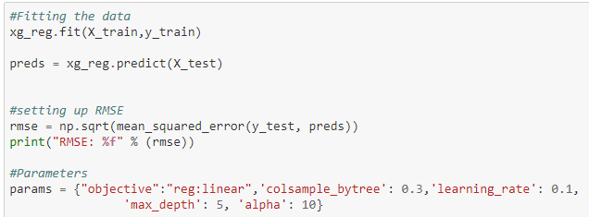
XG Boost

Slide 19
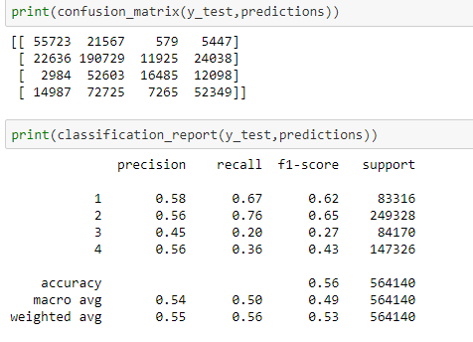
MLP (Multiple Layer Perceptron)

Slide 20
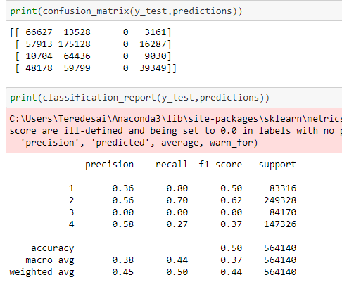
MLP classifier with different layers

Slide 21
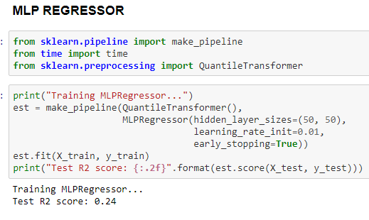
MLP Regressor Using Pipeline and calculating R2 Score

Slide 22
Model Evaluation
Decision tree accuracy 98.28%
Linear Regression Score is 0.04
Random Forest accuracy is 79.62%
Gradient Boosting accuracy is 55%
Root mean square error of XG boost is 0.934187

Slide 23

Model with best accuracy
Decision tree is the best model because it is giving accuracy of 98.28%

Slide 24
Visualization

Slide 25
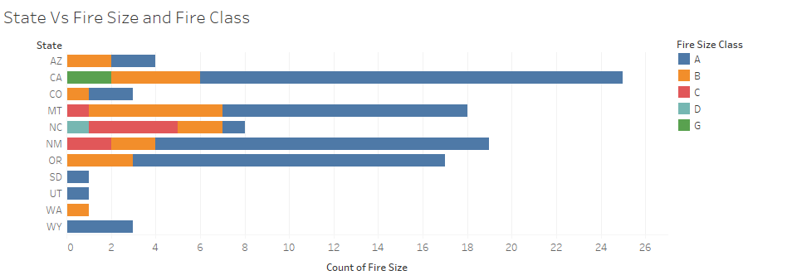
Comparing States with Fire Class and Fire Size

Slide 26
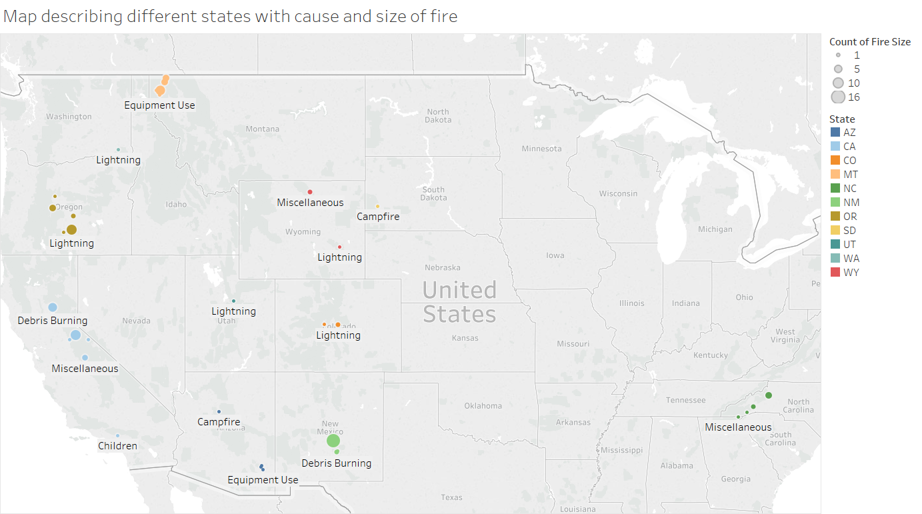
Map showing fire cause and fire size

Slide 27
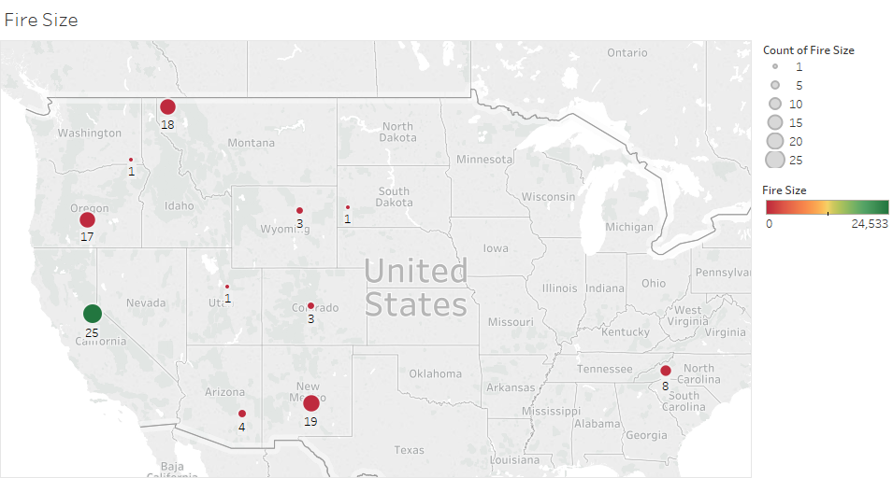
Fire Size across US

Slide 28
Challenges Faced:
Large Data Set: Takes a lot of time to load on machine
Connecting Data Set in python
Difficulty in connecting Sqlite Data Set to tableau

Slide 29
References:
Kaggle.com. 2020. 1.88 Million US Wildfires. [online] Available at: <https://www.kaggle.com/rtatman/188-million-us-wildfires> [Accessed 10 April 2020].
Wildfires. (2020). Retrieved 19 February 2020, from https://www.getprepared.gc.ca/cnt/hzd/wldfrs-en.aspx
Spatial wildfire occurrence data for the United States, 1992-2015 [FPA_FOD_4thedition]. (2020). Retrieved 19 February 2020, from https://data.fs.usda.gov/geodata/edw/edw_resources/meta/S_USA.FPA_FOD_4thedition.xml

Slide 30

Thank you

